Slide 1
Ecological and Human Health: Holistic assessments and solutions
Charles Menzie, Ph.D.
camenzie@exponent.com
February 25, 2021

Slide 2

Health and human well being

Slide 3
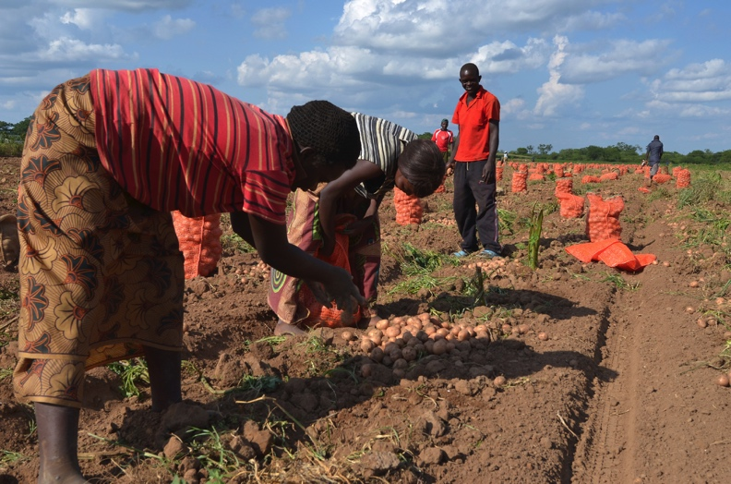


Assessments of risk may involve people that vary in age, activity, and location
Notes:
A lot of photos showing people that might be particularly vulnerable
Children = very vulnerable life stage as they are growing
Farmers
Mining
Fishing – contaminants in the fish but also sustainability of the fishing resource

Slide 4


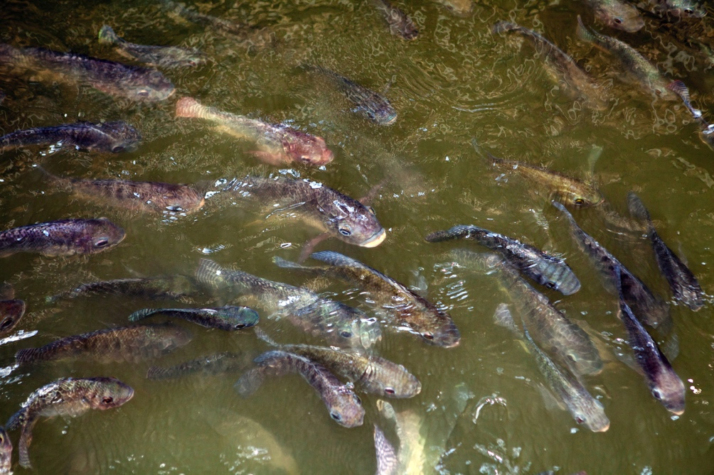


Assessments of risk may involve different types of ecological receptors
Notes:
A lot of photos showing people that might be particularly vulnerable
Children = very vulnerable life stage as they are growing
Farmers
Mining
Fishing – contaminants in the fish but also sustainability of the fishing resource

Slide 5

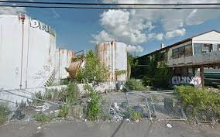


Assessments may involve different habitats, ecosystems, and human environments
Notes:
In that the pics will be changed out, I didn’t bother to resize.

Slide 6

Holistic assessments bring forward concepts of
“One Health”, “Planetary Health”, and “Environmental Justice”
Risk assessment to improve health outcomes and well-being of humans, animals and plants and to promote environmental resilience
Source: www.onehealthcommission.com

Slide 7
Key developments within past few decades
Adverse outcome pathways (AOPs)
“Ecosystem services” as a bridge between humans and the environment
Cumulative risk assessment and environmental justice issues
Integrated human and ecological risk assessment
Increased emphasis on microbial risk assessment (microbes as the receptors)

Slide 8
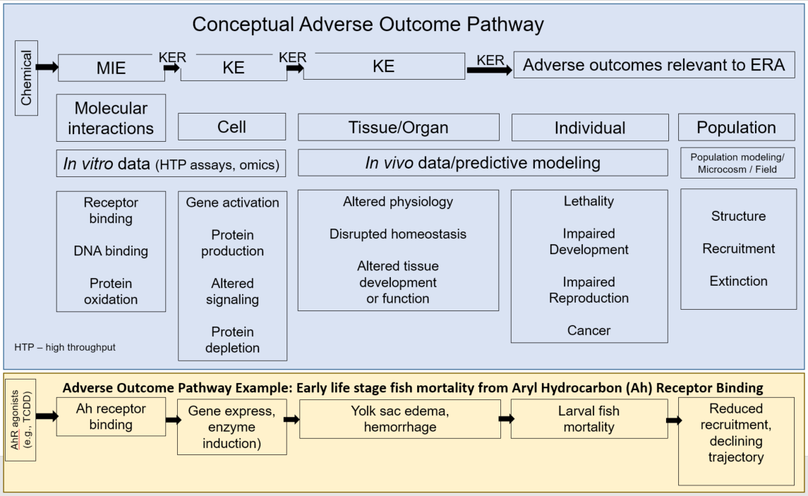
Conceptual AOP showing molecular initiating event (MIE), key events (KEs), key event relationships (KERs) that link to adverse outcome(s) relevant to ERA (adapted from Ankley et al. 2010)

Slide 9

Definition of Ecosystem Services
The outputs of ecological processes that contribute to social welfare or have the potential to do so in the future

Slide 10




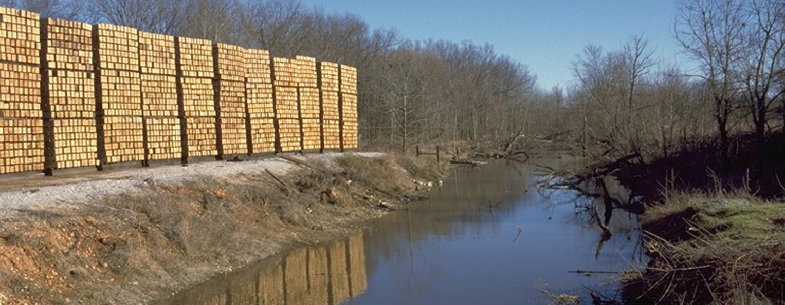
Examples of Ecosystem Services
The food and recreational pleasure that a healthy fish population in a river provides to anglers
The recreational pleasures we receive from having ample clean surface water for swimming in a lake
The production of ample lumber from a forest that allows us to build homes

Slide 11
Considering ecosystem services
Ecosystem services have been part of U.S. environmental regulatory frameworks since the 1970s (e.g., CWA and NEPA).
2005 Millennium Ecosystem Assessment sets out a framework
EU has moved forward with approaches for chemical assessments
  Implementation plans in development
EPA ORD including Center for Environmental Solutions & Emergency Response (CESER)
  Guidance for inclusion as Assessment Endpoints in Risk Assessment
  New efforts to bridge to Superfund with future guidance
EPA Superfund Program
  No formal/regulatory position but many connections to ES
  Integrated approaches including ES dependent on the stakeholders

Slide 12
Cumulative and integrated risk assessments
As defined in the EPA (2003) Framework for Cumulative Risk Assessment, “cumulative risk” means “the combined risks from aggregate exposures to multiple agents or stressors.”
Frameworks for integrating human health and ecological risk assessment were introduced in the early part of the 21st century via collaborations with the World Health Organization (Munns et al, 2003; WHO, 2020 for workshop documents)
Integrated assessments convey how varied, disparate ecological health and environmental effects of a stressor ultimately bear on human health and wellbeing.

Slide 13
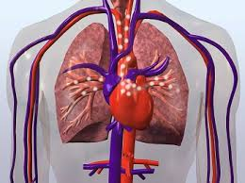
A look at cumulative and integrated risk in relation to cardiovascular disease

Slide 14
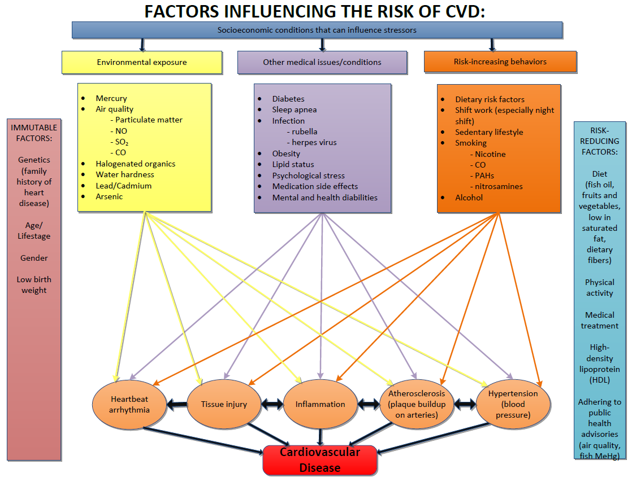
The conceptual model: stressor categories

Slide 15
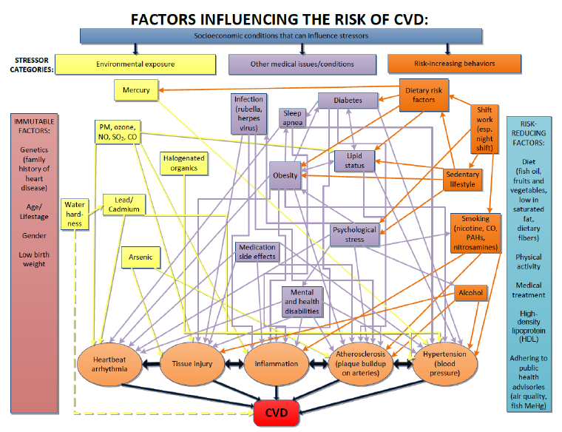
The conceptual model: influence diagram

Slide 16
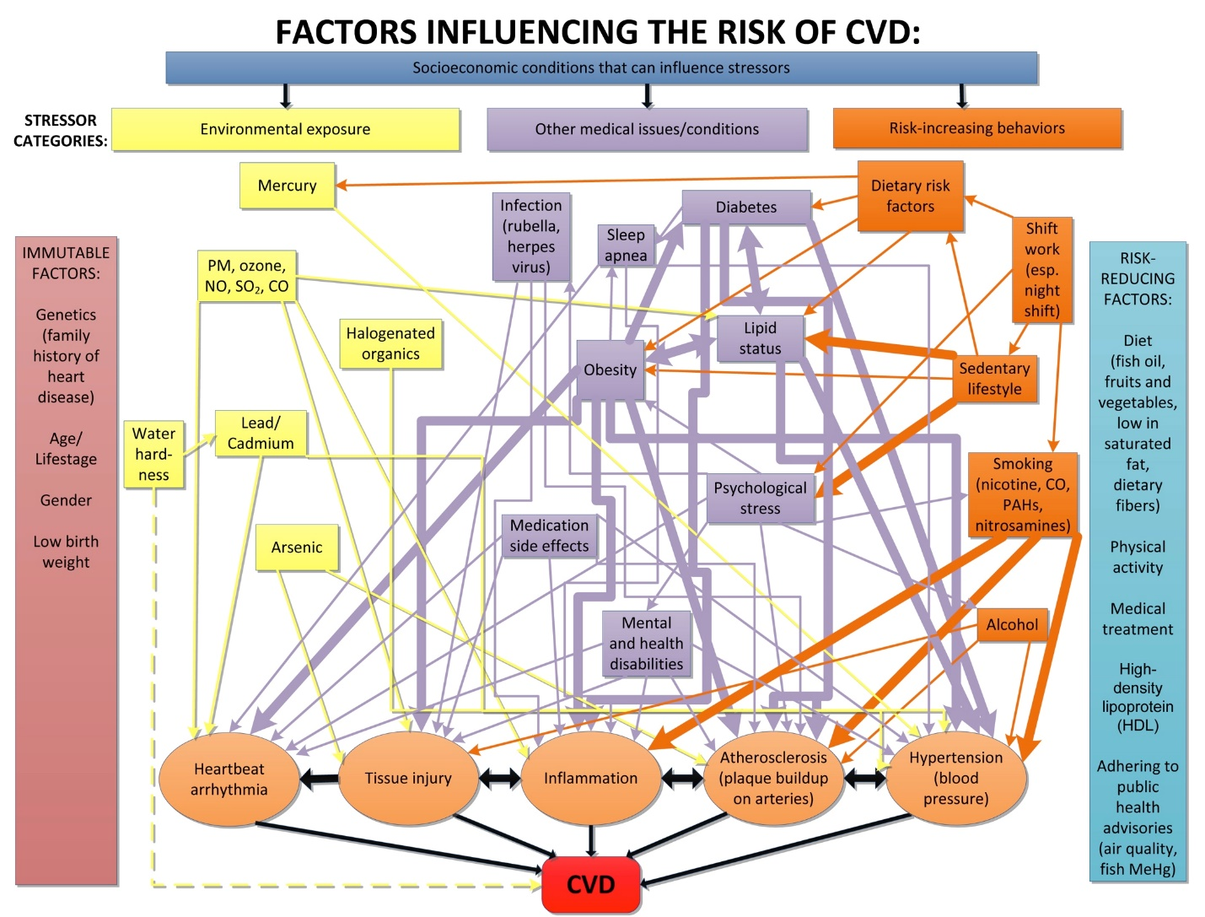
Framingham study factors highlighted

Slide 17
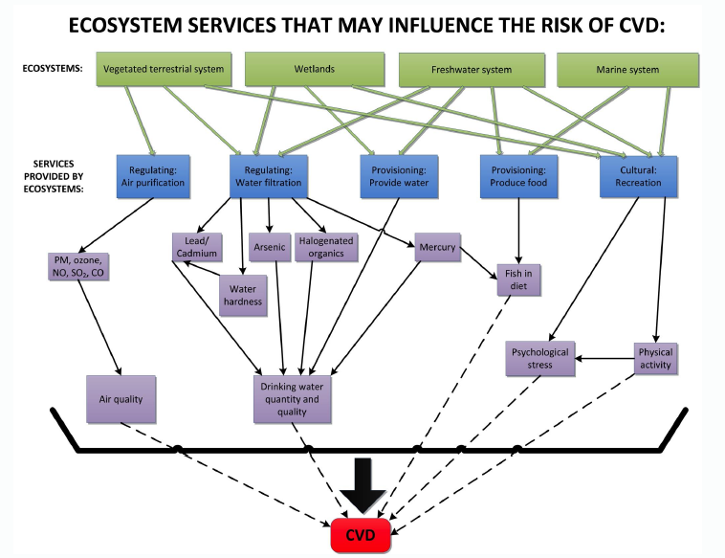
Conceptual model: incorporating ecosystem services

Slide 18
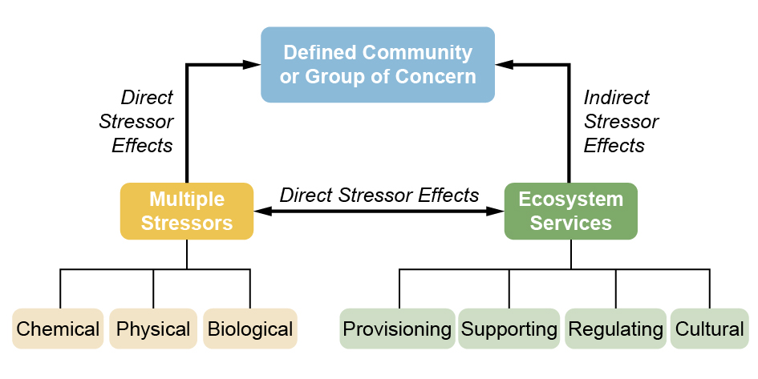
An approach for integrating risks to human health and ecosystem services

Slide 19
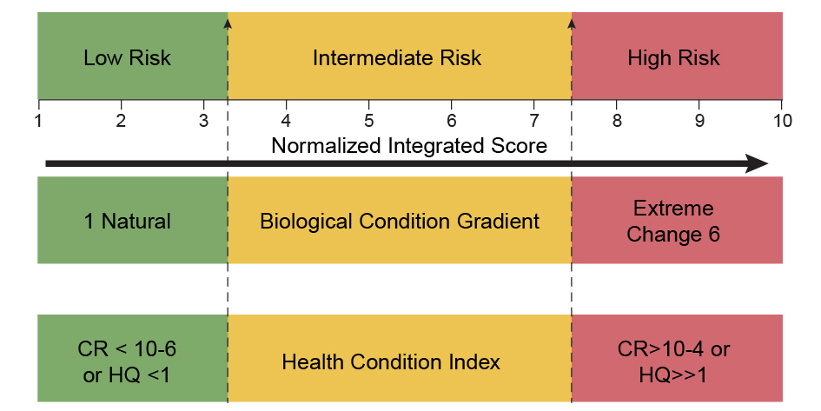
Illustration of relative risk scaling for health and ecological risks for purposes of integration.

Slide 20
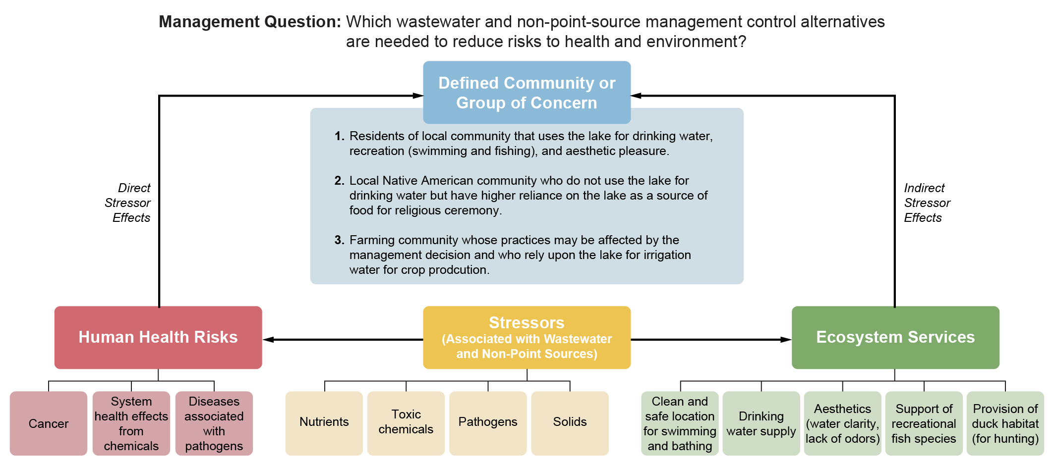
A hypothetical example of approach

Slide 21
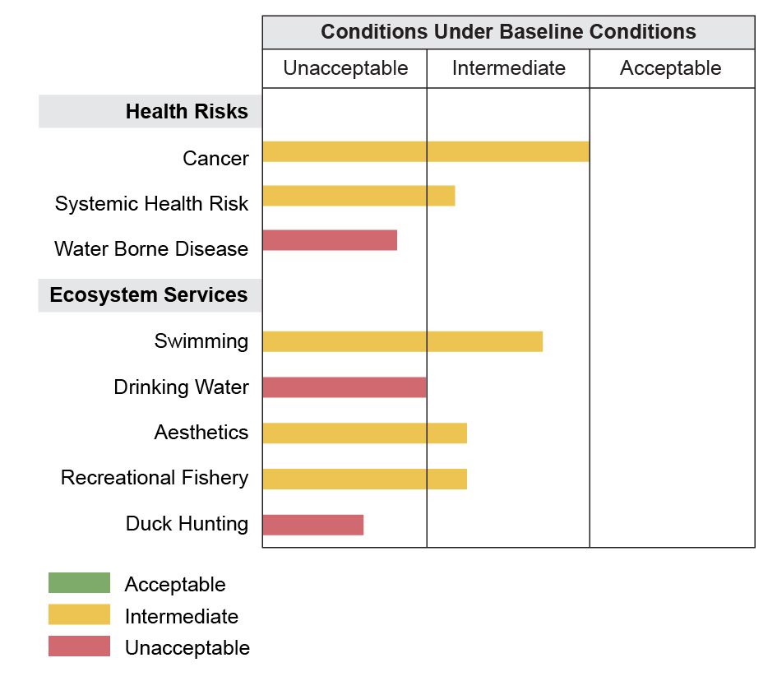
Baseline health risks and status of ecosystem services for the case evaluating wastewater treatment alternatives across the three assessment groups.

Slide 22
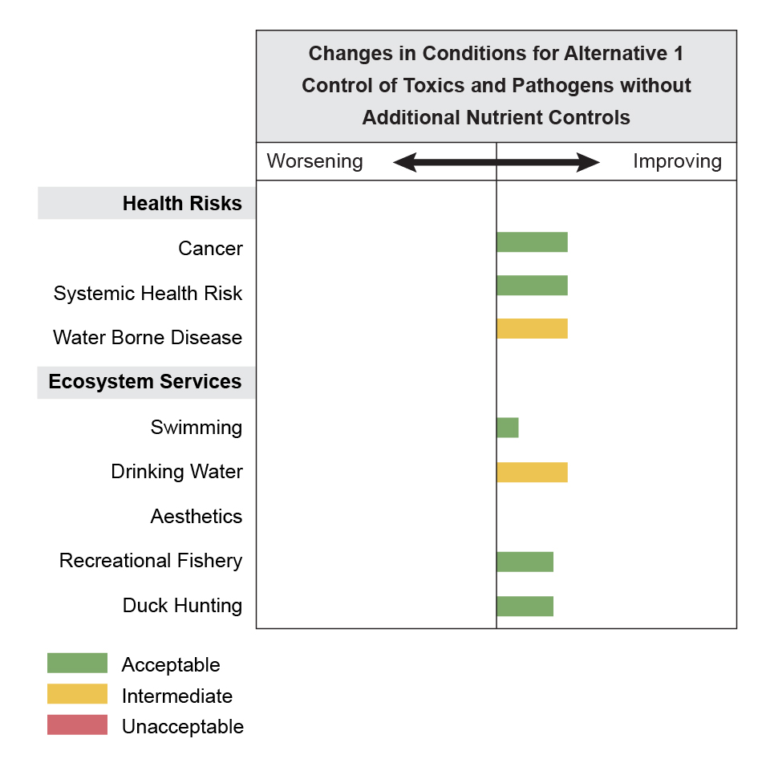
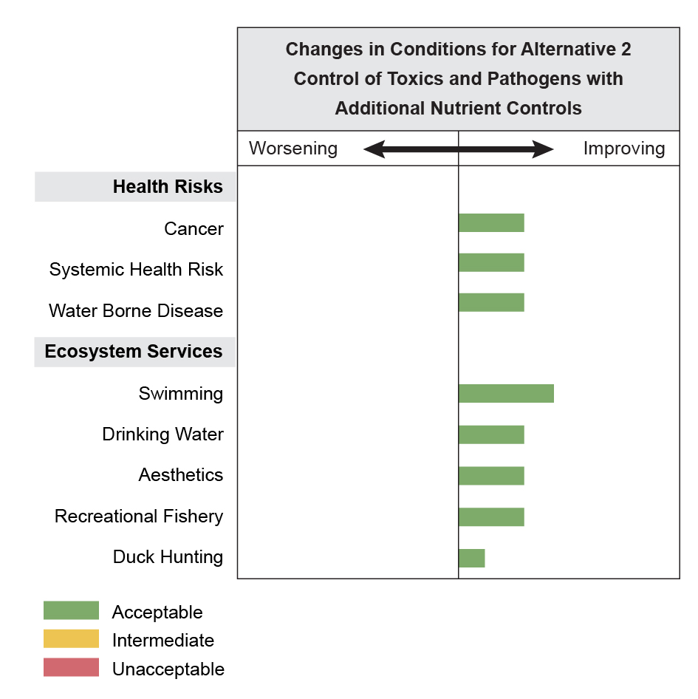
Changes in relative human health and ecological risks for a wastewater treatment alternatives

Slide 23
Anticipate increased inclusion of microorganisms in risk assessments

Slide 24
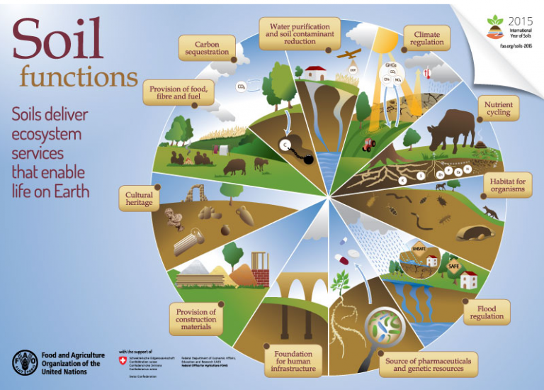
Risks to microorganisms will likely include framing in terms of ecosystem services

Slide 25
Final notes
Holistic assessments are receiving increased attention dovetailing with One Health, Planetary Health, and Environmental Justice
Ecosystem services will be a means of translation from the environment to human well being
Problem formulation and conceptual models are critical for laying out risk factors and for defining responsibilities across agencies
Multidisciplinary teams will be essential
Risk assessment and causal analyses will support each other
Relative risk approaches will be increasingly used to convey information

